Slide 1



Elements of an Android Intent (Part 1)
Douglas C. Schmidt
d.schmidt@vanderbilt.edu www.dre.vanderbilt.edu/~schmidt
Institute for Software Integrated Systems Vanderbilt University Nashville, Tennessee, USA

Slide 2
Learning Objectives in this Part of the Lesson
1. Name all six of the elements in an Android intent
Element | Purpose
Name | Name for a component to handle intent (optional)
Action | A string naming the operation to perform or in case of broadcast intents the event that has occurred & is being reported
Data | URI of data to be acted on & the MIME type of that data
Category | String giving additional info about the action to execute
Extras | Key-value pairs for additional information that should be delivered to component handling the intent
Flags | Flags of various sorts
2

Slide 3



Learning Objectives in this Part of the Lesson
Name all six of the elements in an Android intent
Understand how the Intent API is used to pass info to components
Element | Purpose
Name | Name for a component to handle intent (optional)
Action | A string naming the operation to perform or in case of broadcast intents the event that has occurred & is being reported
Data | URI of data to be acted on & the MIME type of that data
Category | String giving additional info about the action to execute
Extras | Key-value pairs for additional information that should be delivered to component handling the intent
Flags | Flags of various sorts
Activity₁
Intent
Activity₂
App
2

Slide 4



Learning Objectives in this Part of the Lesson
Name all six of the elements in an Android intent
Understand how the Intent API is used to pass info to components
Element | Purpose
Name | Name for a component to handle intent (optional)
Action | A string naming the operation to perform or in case of broadcast intents the event that has occurred & is being reported
Data | URI of data to be acted on & the MIME type of that data
Category | String giving additional info about the action to execute
Extras | Key-value pairs for additional information that should be delivered to component handling the intent
Flags | Flags of various sorts
Activity₁
Intent
Activity₂
App
This part of the lesson focuses o4n concepts & a few code snippets

Slide 5
Overview of the Elements in an Android Intent
5

Slide 6
Overview of the Elements in an Android Intent
An Intent contains a # of elements
Element | Purpose
Name | Name for a component to handle intent (optional)
Action | A string naming the operation to perform or in case of broadcast intents the event that has occurred & is being reported
Data | URI of data to be acted on & the MIME type of that data
Category | String giving additional info about the action to execute
Extras | Key-value pairs for additional information that should be delivered to component handling the intent
Flags | Flags of various sorts
See developer.android.com/refer6ence/android/content/Intent.html

Slide 7






Overview of the Elements in an Android Intent
An Intent contains a # of elements
Some elements are of interest to app component(s) that receive it
Element | Purpose
Name | Name for a component to handle intent (optional)
Action | A string naming the operation to perform or in case of broadcast intents the event that has occurred & is being reported
Data | URI of data to be acted on & the MIME type of that data
Category | String giving additional info about the action to execute
Extras | Key-value pairs for additional information that should be delivered to component handling the intent
Flags | Flags of various sorts
MainActivity
Intent
+ URI
Intent
+ URL
Download Service
Gallery Activity
ImageDownloadApp
See developer.android.com/refer6ence/android/content/Intent.html

Slide 8


Overview of the Elements in an Android Intent
An Intent contains a # of elements
Some elements are of interest to app component(s) that receive it
Other elements are of interest to Android’s intent framework itself
Activity Manager Service
Element | Purpose
Name | Name for a component to handle intent (optional)
Action | A string naming the operation to perform or in case of broadcast intents the event that has occurred & is being reported
Data | URI of data to be acted on & the MIME type of that data
Category | String giving additional info about the action to execute
Extras | Key-value pairs for additional information that should be delivered to component handling the intent
Flags | Flags of various sorts
See developer.android.com/refer6ence/android/content/Intent.html

Slide 9

Overview of the Elements in an Android Intent
These elements define a language for expressing user “intent”
Element | Purpose
Name | Name for a component to handle intent (optional)
Action | A string naming the operation to perform or in case of broadcast intents the event that has occurred & is being reported
Data | URI of data to be acted on & the MIME type of that data
Category | String giving additional info about the action to execute
Extras | Key-value pairs for additional information that should be delivered to component handling the intent
Flags | Flags of various sorts

Slide 10
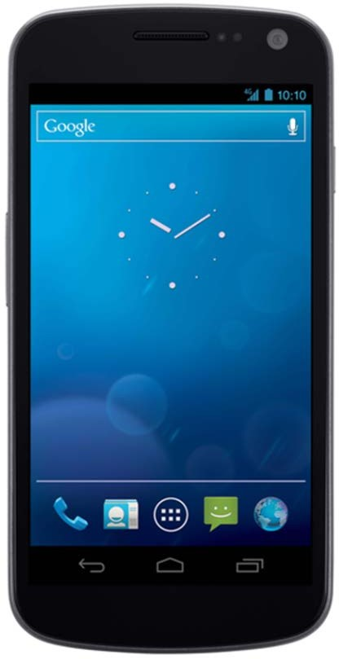
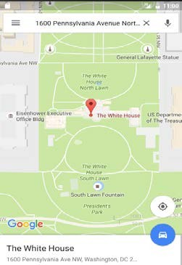
Overview of the Elements in an Android Intent
These elements define a language for expressing user “intent”, e.g.
“map a street address”
Element | Purpose
Name | Name for a component to handle intent (optional)
Action | A string naming the operation to perform or in case of broadcast intents the event that has occurred & is being reported
Data | URI of data to be acted on & the MIME type of that data
Category | String giving additional info about the action to execute
Extras | Key-value pairs for additional information that should be delivered to component handling the intent
Flags | Flags of various sorts

Slide 11
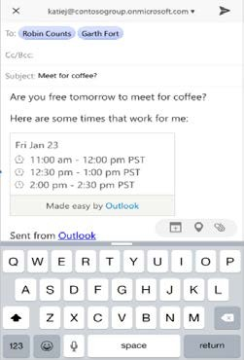
Overview of the Elements in an Android Intent
These elements define a language for expressing user “intent”, e.g.
“read an email”
Element | Purpose
Name | Name for a component to handle intent (optional)
Action | A string naming the operation to perform or in case of broadcast intents the event that has occurred & is being reported
Data | URI of data to be acted on & the MIME type of that data
Category | String giving additional info about the action to execute
Extras | Key-value pairs for additional information that should be delivered to component handling the intent
Flags | Flags of various sorts

Slide 12

Overview of the Elements in an Android Intent
These elements define a language for expressing user “intent”, e.g.
“browse a URL”
Element | Purpose
Name | Name for a component to handle intent (optional)
Action | A string naming the operation to perform or in case of broadcast intents the event that has occurred & is being reported
Data | URI of data to be acted on & the MIME type of that data
Category | String giving additional info about the action to execute
Extras | Key-value pairs for additional information that should be delivered to component handling the intent
Flags | Flags of various sorts

Slide 13


Overview of the Elements in an Android Intent
These elements define a language for expressing user “intent”, e.g.
“call Sauron’s Palantir”
Element | Purpose
Name | Name for a component to handle intent (optional)
Action | A string naming the operation to perform or in case of broadcast intents the event that has occurred & is being reported
Data | URI of data to be acted on & the MIME type of that data
Category | String giving additional info about the action to execute
Extras | Key-value pairs for additional information that should be delivered to component handling the intent
Flags | Flags of various sorts

Slide 14

Overview of the Elements in an Android Intent
These elements define a language for expressing user “intent”
Element | Purpose
Name | Name for a component to handle intent (optional)
Action | A string naming the operation to perform or in case of broadcast intents the event that has occurred & is being reported
Data | URI of data to be acted on & the MIME type of that data
Category | String giving additional info about the action to execute
Extras | Key-value pairs for additional information that should be delivered to component handling the intent
Flags | Flags of various sorts
Allows apps to focus on1t4he “what,” not the “how”

Slide 15

Overview of the Elements in an Android Intent
An Intent may contain the name of the target component
Element | Purpose
Name | Name for a component to handle intent (optional)
Action | A string naming the operation to perform or in case of broadcast intents the event that has occurred & is being reported
Data | URI of data to be acted on & the MIME type of that data
Category | String giving additional info about the action to execute
Extras | Key-value pairs for additional information that should be delivered to component handling the intent
Flags | Flags of various sorts
15

Slide 16

Overview of the Elements in an Android Intent
An Intent may contain the name of the target component
Element | Purpose
Name | Name for a component to handle intent (optional)
Action | A string naming the operation to perform or in case of broadcast intents the event that has occurred & is being reported
Data | URI of data to be acted on & the MIME type of that data
Category | String giving additional info about the action to execute
Extras | Key-value pairs for additional information that should be delivered to component handling the intent
Flags | Flags of various sorts
The target component name16is optional, as discussed later

Slide 17



Overview of the Elements in an Android Intent
If the name is specified the intent is called an “explicit intent”
Element | Purpose
Name | Name for a component to handle intent (optional)
Action | A string naming the operation to perform or in case of broadcast intents the event that has occurred & is being reported
Data | URI of data to be acted on & the MIME type of that data
Category | String giving additional info about the action to execute
Extras | Key-value pairs for additional information that should be delivered to component handling the intent
Flags | Flags of various sorts
Activity
1
Activity₁ uses an explicit intent to start Service₁
Service₁
See www.vogella.com/tutorials/Andr1o7idIntent/article.html#intents_implicit

Slide 18
Overview of the Elements in an Android Intent
If name is omitted other elements identify the target component(s)
Element | Purpose
Name | Name for a component to handle intent (optional)
Action | A string naming the operation to perform or in case of broadcast intents the event that has occurred & is being reported
Data | URI of data to be acted on & the MIME type of that data
Category | String giving additional info about the action to execute
Extras | Key-value pairs for additional information that should be delivered to component handling the intent
Flags | Flags of various sorts

Slide 19
Overview of the Elements in an Android Intent
If name is omitted other elements identify the target component(s)
e.g., the action to perform, data to act on, etc.
Element | Purpose
Name | Name for a component to handle intent (optional)
Action | A string naming the operation to perform or in case of broadcast intents the event that has occurred & is being reported
Data | URI of data to be acted on & the MIME type of that data
Category | String giving additional info about the action to execute
Extras | Key-value pairs for additional information that should be delivered to component handling the intent
Flags | Flags of various sorts

Slide 20


Overview of the Elements in an Android Intent
If the name is not specified the intent is called an “implicit intent”
Element | Purpose
Name | Name for a component to handle intent (optional)
Action | A string naming the operation to perform or in case of broadcast intents the event that has occurred & is being reported
Data | URI of data to be acted on & the MIME type of that data
Category | String giving additional info about the action to execute
Extras | Key-value pairs for additional information that should be delivered to component handling the intent
Flags | Flags of various sorts
Activity
1
Activity₁ uses an implicit intent to start Activity₂
Activity₂
See www.vogella.com/tutorials/Andr2o0idIntent/article.html#intents_explicit

Slide 21
Overview of the Elements in an Android Intent
If the name is not specified the intent is called an “implicit intent”
Android’s intent framework uses some elements in the intent to identify the target component as part of “intent resolution”
Element | Purpose
Name | Name for a component to handle intent (optional)
Action | A string naming the operation to perform or in case of broadcast intents the event that has occurred & is being reported
Data | URI of data to be acted on & the MIME type of that data
Category | String giving additional info about the action to execute
Extras | Key-value pairs for additional information that should be delivered to component handling the intent
Flags | Flags of various sorts
See developer.android.com/guid₂e₁/components/intents-filters.html

Slide 22




Overview of the Elements in an Android Intent
ACTION_BATTERY_LOW is an example of an implicit intent
Element | Purpose
Name | Name for a component to handle intent (optional)
Action | A string naming the operation to perform or in case of broadcast intents the event that has occurred & is being reported
Data | URI of data to be acted on & the MIME type of that data
Category | String giving additional info about the action to execute
Extras | Key-value pairs for additional information that should be delivered to component handling the intent
Flags | Flags of various sorts
Phone App
System Server
Activity Manager Service
Battery Service
22

Slide 23
Overview of the Elements in an Android Intent
ACTION_BATTERY_LOW is an example of an implicit intent
e.g., sent by the Battery Service when power levels fall below a given threshold
Element | Purpose
Name | Name for a component to handle intent (optional)
Action | A string naming the operation to perform or in case of broadcast intents the event that has occurred & is being reported
Data | URI of data to be acted on & the MIME type of that data
Category | String giving additional info about the action to execute
Extras | Key-value pairs for additional information that should be delivered to component handling the intent
Flags | Flags of various sorts
Phone App
System Server
Activity Manager Service
Battery Service
intent
Elements in an intent are set by t2h3e intent creator/sender component

Slide 24


Overview of the Elements in an Android Intent
ACTION_BATTERY_LOW is an example of an implicit intent
e.g., sent by the Battery Service when power levels fall below a given threshold
Element | Purpose
Name | Name for a component to handle intent (optional)
Action | A string naming the operation to perform or in case of broadcast intents the event that has occurred & is being reported
Data | URI of data to be acted on & the MIME type of that data
Category | String giving additional info about the action to execute
Extras | Key-value pairs for additional information that should be delivered to component handling the intent
Flags | Flags of various sorts
Phone App
System Server
intent
Activity Manager Service
Battery Service
ActivityManagerService (AMS) deliver2s4implicit intents to interested receivers

Slide 25


Overview of the Elements in an Android Intent
ACTION_BATTERY_LOW is an example of an implicit intent
e.g., sent by the Battery Service when power levels fall below a given threshold
Element | Purpose
Name | Name for a component to handle intent (optional)
Action | A string naming the operation to perform or in case of broadcast intents the event that has occurred & is being reported
Data | URI of data to be acted on & the MIME type of that data
Category | String giving additional info about the action to execute
Extras | Key-value pairs for additional information that should be delivered to component handling the intent
Flags | Flags of various sorts
Phone App
System Server
Broadcast Receivers
intent
intent
Activity Manager Service
Battery Service
BroadcastReceiver(s) are notified by th2e5 AMS when an event of interest occurs

Slide 26
Overview of the Elements in an Android Intent
ACTION_BATTERY_LOW is an example of an implicit intent
e.g., sent by the Battery Service when power levels fall below a given threshold
Element | Purpose
Name | Name for a component to handle intent (optional)
Action | A string naming the operation to perform or in case of broadcast intents the event that has occurred & is being reported
Data | URI of data to be acted on & the MIME type of that data
Category | String giving additional info about the action to execute
Extras | Key-value pairs for additional information that should be delivered to component handling the intent
Flags | Flags of various sorts
Phone App
System Server
Broadcast Receivers
intent
intent
Activity Manager Service
Battery Service
A Broadcast Receiver’s onReceive() h2o6ok method is notified with the intent

Slide 27
Overview of the Elements in an Android Intent
An intent also contains elements of interest to the Android system
Element | Purpose
Name | Name for a component to handle intent (optional)
Action | A string naming the operation to perform or in case of broadcast intents the event that has occurred & is being reported
Data | URI of data to be acted on & the MIME type of that data
Category | String giving additional info about the action to execute
Extras | Key-value pairs for additional information that should be delivered to component handling the intent
Flags | Flags of various sorts
Phone App
System Server
intent
Activity Manager Service
Battery Service
See anatomyofandroid.com2/27013/10/16/activity-manager

Slide 28
Overview of the Elements in an Android Intent
An intent also contains elements of interest to the Android system
e.g., category of component to handle intent, instructions on how to launch an Activity, etc.
Element | Purpose
Name | Name for a component to handle intent (optional)
Action | A string naming the operation to perform or in case of broadcast intents the event that has occurred & is being reported
Data | URI of data to be acted on & the MIME type of that data
Category | String giving additional info about the action to execute
Extras | Key-value pairs for additional information that should be delivered to component handling the intent
Flags | Flags of various sorts
Phone App
System Server
intent
Activity Manager Service
Battery Service
The ActivityManager Service “rout2e8s” intents to BroadcastReceiver(s)

Slide 29
Overview of the Intent API
29

Slide 30

Overview of the Intent API
The Intent API is vast & imposing
See developer.android.com/refer3e0nce/android/content/Intent.html

Slide 31
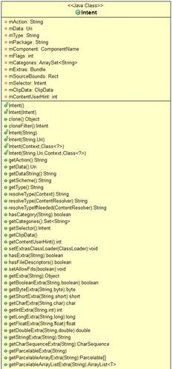
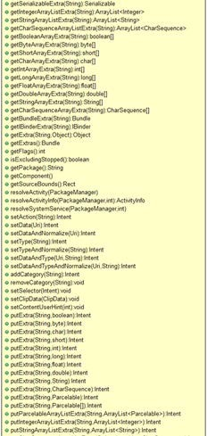
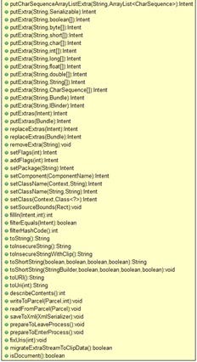
Overview of the Intent API
The Intent API is vast & imposing
It contains dozens of setter/getter methods for its fields
See developer.android.com/refer3e1nce/android/content/Intent.html

Slide 32
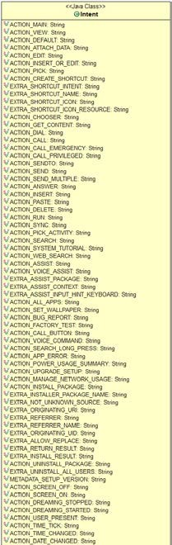
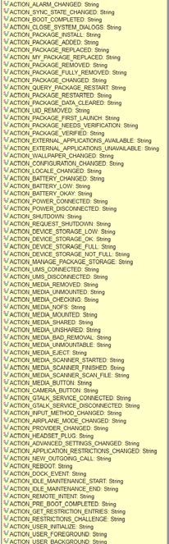
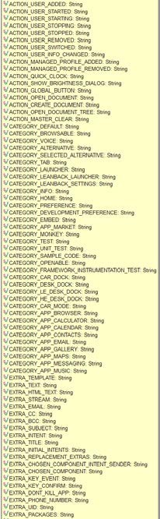
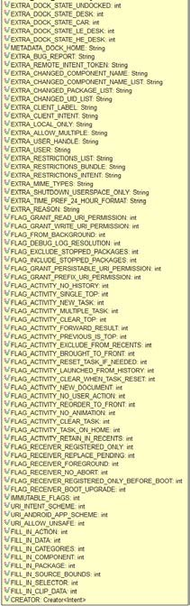
Overview of the Intent API
The Intent API is vast & imposing
It contains dozens of setter/getter methods for its fields
It contains scores of symbolic constants
See developer.android.com/refer3e2nce/android/content/Intent.html

Slide 33

Overview of the Intent API
The Intent API is vast & imposing
We aren’t going to cover all methods,3f3ields, & constants in the Intent class!!

Slide 34



Overview of the Intent API
The Intent API is used for a similar purpose as
passing parameters to a method call
Intent intent = new Intent(ACTION_VIEW,
data); intent.putExtra("Today", "July 18, 2016");
intent.putExtra("Pi", 3.1416);
intent.putExtra("isHot", true); intent.putExtra("Answer", 42);
Activity₁
Intent
Activity₂
App
startActivity(intent);
versus
startActivity(ACTION_VIEW, data, param1,
param2, param3, param4);
See developer.android.com/tra3in4ing/basics/intents/sending.html

Slide 35



Overview of the Intent API
The Intent API is used for a similar purpose as
passing parameters to a method call
Intent intent = new Intent(ACTION_VIEW,
data); intent.putExtra("Today", "July 18, 2016");
intent.putExtra("Pi", 3.1416);
intent.putExtra("isHot", true); intent.putExtra("Answer", 42);
Activity₁
Intent
Activity₂
App
startActivity(intent);
Senders use setter methods to populate intent fields
versus
startActivity(ACTION_VIEW, data, param1,
param2, param3, param4);

Slide 36


Overview of the Intent API
The Intent API is used for a similar purpose as
passing parameters to a method call
Intent intent = new Intent(ACTION_VIEW,
data); intent.putExtra("Today", "July 18, 2016");
intent.putExtra("Pi", 3.1416);
intent.putExtra("isHot", true); intent.putExtra("Answer", 42);
Activity₁
Intent
Activity₂
App
startActivity(intent);
The intent can then be sent to the desired component
versus
startActivity(ACTION_VIEW, data, param1,
param2, param3, param4);

Slide 37


Overview of the Intent API
The Intent API is used for a similar purpose as
passing parameters to a method call
Intent intent = new Intent(ACTION_VIEW,
data); intent.putExtra("Today", "July 18, 2016");
intent.putExtra("Pi", 3.1416);
intent.putExtra("isHot", true); intent.putExtra("Answer", 42);
Activity₁
Intent
Activity₂
App
startActivity(intent);
A hypothetical “varargs” version of startActivity()
versus
startActivity(ACTION_VIEW, data, param1,
param2, param3, param4);
See docs.oracle.com/javase/1.5.03/7docs/guide/language/varargs.html

Slide 38



Overview of the Intent API
The Intent API is used for a similar purpose as
passing parameters to a method call
Intent intent = new Intent(ACTION_VIEW,
data); intent.putExtra("Today", "July 18, 2016");
intent.putExtra("Pi", 3.1416);
intent.putExtra("isHot", true); intent.putExtra("Answer", 42);
Activity₁
Intent
Activity₂
App
startActivity(intent);
Intents are (arguably) more flexible & parsimonious than passing many parameters to method calls
versus
startActivity(ACTION_VIEW, data, param1,
param2, param3, param4);

Slide 39

Overview of the Intent API
The component receiving an intent uses getter
methods to extract data inserted by the sender
Intent i = getIntent();
Activity₁
Intent
Uri data String s
= i.getData();
= i.getStringExtra("Today");
Activity₂
Float f = i.getFloatExtra("Pi");
App
Boolean b = i.getBooleanExtra("isHot"); Integer n = i.getIntegerExtra("Answer");

Slide 40
Overview of the Intent API
The component receiving an intent uses getter
methods to extract data inserted by the sender
Intent i = getIntent();
Activity₁
Intent
Uri data String s
= i.getData();
= i.getStringExtra("Today");
Activity₂
Float f = i.getFloatExtra("Pi");
App
Boolean b = i.getBooleanExtra("isHot"); Integer n = i.getIntegerExtra("Answer");
There are various ways for a com4p0onent to get its associated intent

Slide 41
Overview of the Intent API
The component receiving an intent uses getter
methods to extract data inserted by the sender
Intent i = getIntent();
Activity₁
Intent
Uri data String s
= i.getData();
= i.getStringExtra("Today");
Activity₂
Float f = i.getFloatExtra("Pi");
App
Boolean b = i.getBooleanExtra("isHot"); Integer n = i.getIntegerExtra("Answer");
41

Slide 42

Overview of the Intent API
The component receiving an intent uses getter methods to extract data inserted by the sender
Intent i = getIntent();
Uri data String s
= i.getData();
= i.getStringExtra("Today");
Float f = i.getFloatExtra("Pi"); Boolean b = i.getBooleanExtra("isHot"); Integer n = i.getIntegerExtra("Answer");
Only You Can Prevent Type Errors!
App programmers must know corre4c2t element types (or null is returned)

Slide 43
End of Elements in an Android Intent (Part 1)
43

